Slide 1


A catchy title
Strategy description
Insert
Company Logo
Notes:
Find a pic

Slide 2

Executive Summary
Overview
SITUATION
KEY QUESTION
RECOMMENDATION
IMPACT
Situation A
$XXm in incremental revenue by 2023
How can XXX?
Reco 1
Brief description of the solution and objective
Situation B
$XXm in incremental revenue by 2023
How can XXX?
Reco 2
Brief description of the solution and objective
Notes:
Change this

Slide 4

Key question
How XXX?

Slide 5

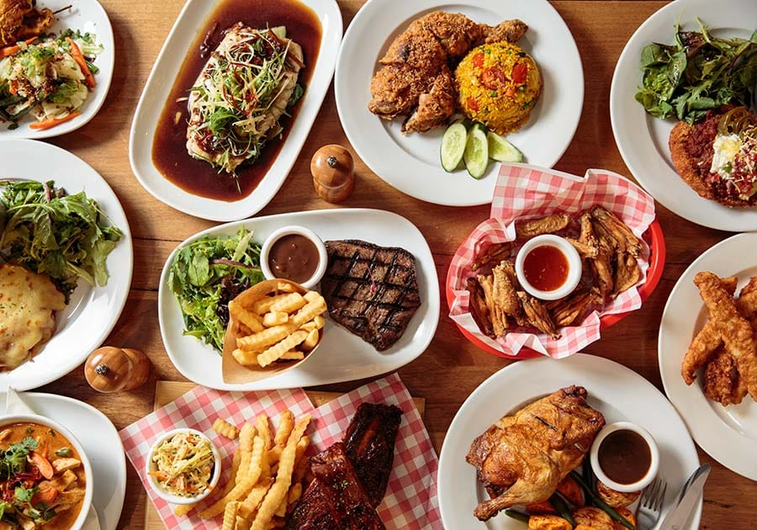
1
2
Recommendation 01
Recommendation 02
Description
Description
478 retained each year

Slide 6
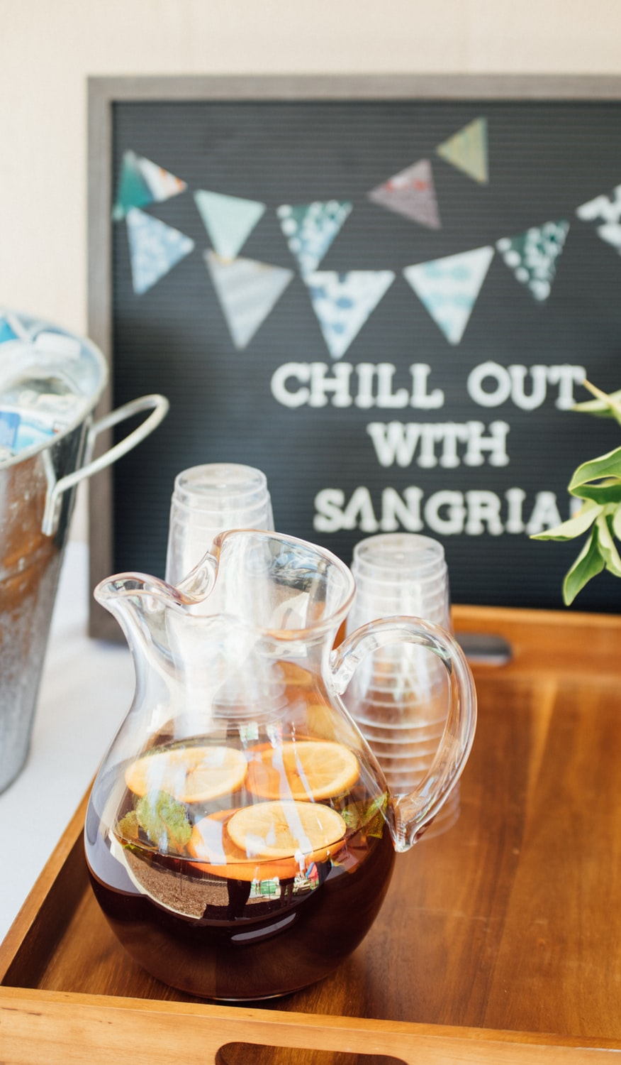

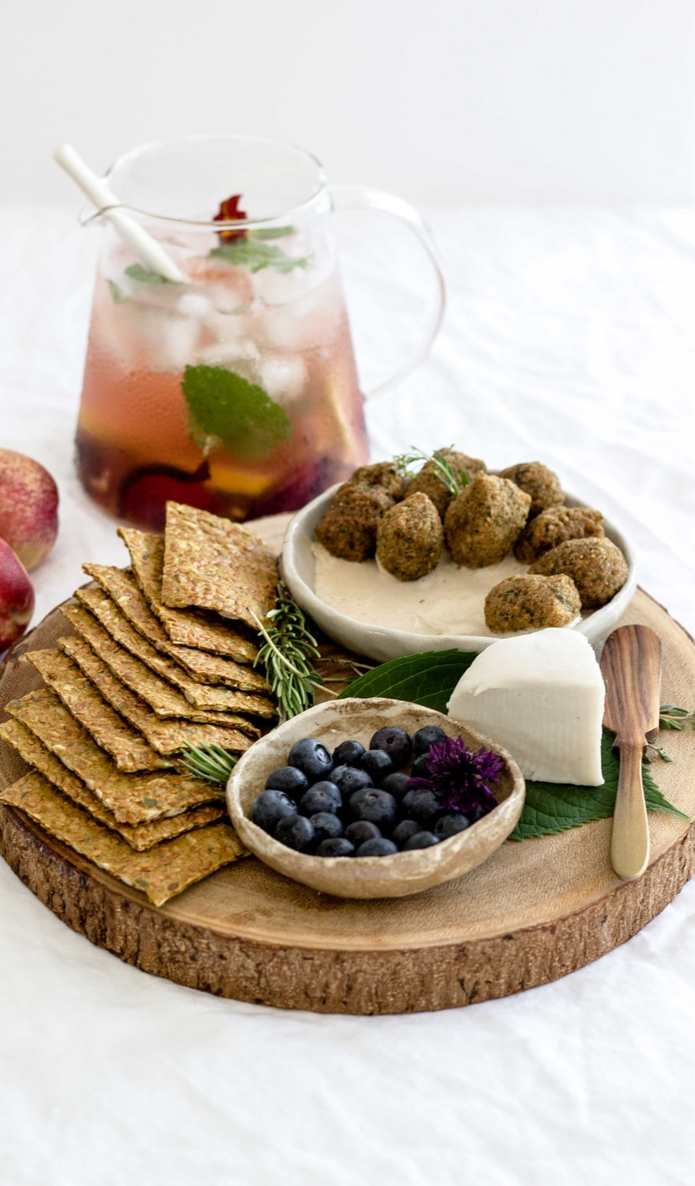
Change the background of the selected strategy to blue
1
2
3
Strategy 1
______________
Description of strategy 1
Strategy 2
______________
Description of strategy 2
Strategy 3
______________
Description of strategy 3
6

Slide 7

Key takeaway
Descriptions..

Slide 8
Impact Analysis
____________

Slide 9
Indices
Instructions
Setting up the slide navigation..
Make sure slides are in correct order
Have “Executive Summary” slide before this one
Run macro in “Adding slide navigation” -- *note: remember to put the two files under the same folder
Organize slides based on its section
Analysis
Impact
Recommendations
Appendix

Slide 10

Slide format guide (Calibri Light 28 pt)
Toolkit
Commonly used boxes (Calibri 18 pt)
Title box (20 pt)
Use more pictures/ icons
Theme
(18 pt)
Content 1 (18 pt)
38%
Content 1 (18 pt)
Content 2 (16 pt)
Content 3 (16 pt)
Key takeaway – please align to the bottom guide (18 pt)

Slide 11
Analysis framework
____________

Slide 12
Company overview/ core competencies
Overview
Vision/ Objective
Build the world’s best company and …
1
2
3
Title
Title
Title
Key takeaway – please align to the bottom guide (18 pt)

Slide 13
Company X is looking for new customer segments to tap into
Strategy Validation – Competitive Positioning
Customer segmentation map I
Customer segmentation map II
High-income
Customer Age
The Professional
The Well-off Retiree
High
1
Younger
Older
The Blue-Collar
The Pensioner
Low
Low-income
Low
High
Willingness to Pay
Example

Slide 14
Company X is positioned as a mass-market product
Strategy Validation – Competitive Positioning
Target Consumer
Positioning Map
Commentary
Premium
Lack of competitors in the premium segment
Low Quality
High Quality
Existing capabilities to
enter the market
Alignment with targeted segment’s needs
Jenny, 24 years old
Lives in Montreal
Works in Finance
Mass
Company X needs to strategically focus efforts on improving their brand and increasing product convenience
Example

Slide 15
Company X needs to address the needs of the Millennial consumer
Strategy Validation – Consumer Analysis
Target Consumer
Purchasing Drivers Analysis
Least important
Most important
Key Purchasing Drivers
Current Focus
Consumer Needs
Commentary
Price
Price is not a large driver for purchases
Product Utility
Brand Equity
Branding and Convenience are key purchasing drivers
Jenny, 24 years old
Lives in Montreal
Works in Finance
Convenience
Company X needs to strategically focus efforts on improving their brand and increasing product convenience
Example

Slide 16



Company X is positioned as a mass-market product
Strategy Alternatives
Alternative Analysis
Criteria
Digital CRM
Blockchain Solution
Chatbot Functionality
BRAND IMAGE
Does it improve its brand image?
FEASBILIITY
Is the firm able to implement it under constraints?
IMPACT
Does it generate sufficient financial benefit?
Example

Slide 17
Company X is positioned as a mass-market product
Strategy Alternatives
Alternative Analysis
Alternatives
Action
Feasibility
3
2
1
Adoption of Frontier Technology
Pursue
High
1
2
Adoption of Frontier Technology
4
3
Product Feature
Enhancement
Wait
5
4
Adoption of Frontier Technology
Low
6
5
Adoption of Frontier Technology
Do not pursue
Low
High
Impact
6
Geographic Market Expansion
Example

Slide 18


Gap analysis
Strategy Validation – Gap Analysis
Where we are today..
Where we want to be..
Description
Description
1
GAP
1
Description
Description
2
2
Description
Description
3
3

Slide 19





(Company) has established foothold across the supply chain
Overview – Value Chain
Industry supply chain
Sourcing
Product development
Assembly
Sales
Post-sales
(Services)
(agreement with Billerud)
Constant validation with clients through prototyping
(lean production)
n/a
Involving end users for market testing
Modification & customization
Key takeaway – please align to the bottom guide (18 pt)

Slide 20
Recommendation
____________

Slide 21


Tri-factors
Objective
To provide 10x values to all stakeholders
Stakeholder relationship
Values to each stakeholder
Stakeholder 1
Stakeholder 2
Stakeholder 3
Content 2 (16 pt)
Content 2 (16 pt)
Content 2 (16 pt)
Instructor
Student
Strategy validation

Slide 22

Introducing…
Strategy Recommendation – Spark 2.0
Recommendation
Spark 2.0 (permanent marker 72 pt)
One-liner description – value proposition (Calibri Light Italic 20 pt)
Key Features
Key Benefits
Shareable content
Shareable content
Shareable content
Shareable content
Shareable content
Shareable content
Example
Notes:
Download Permanent Marker font here: https://www.fontsquirrel.com/fonts/permanent-marker

Slide 23

Customer profile
Strategy Target
“Weird combination for insurance to be in the wedding package”
Key Considerations
1
Market research may not be accurately representing behavior
I would prioritize other things first when planning my marriage
2
Suggests wedding-relevant insurance as a starting point
“I am already worried arranging my wedding, is this necessary”
3
Wedding Ring Insurance
Runaway Groom Insurance
Wedding Dress Stain Insurance
Example

Slide 24
Customer journey
Strategy Walkthrough
Customer Journey
Engage
Purchase
Retain
Share
Objective
To trigger brand awareness for the product
Tactic
Product placement at central business districts
Cafes located in the CBD area
Sponsored vending machines at corporate offices
Jenny, 24 years old
Lives in Montreal
Works in Finance
Impact
Generate brand recognition around the product
Example
Awareness/ Interest
Evaluation of alternative
Purchase

Slide 25
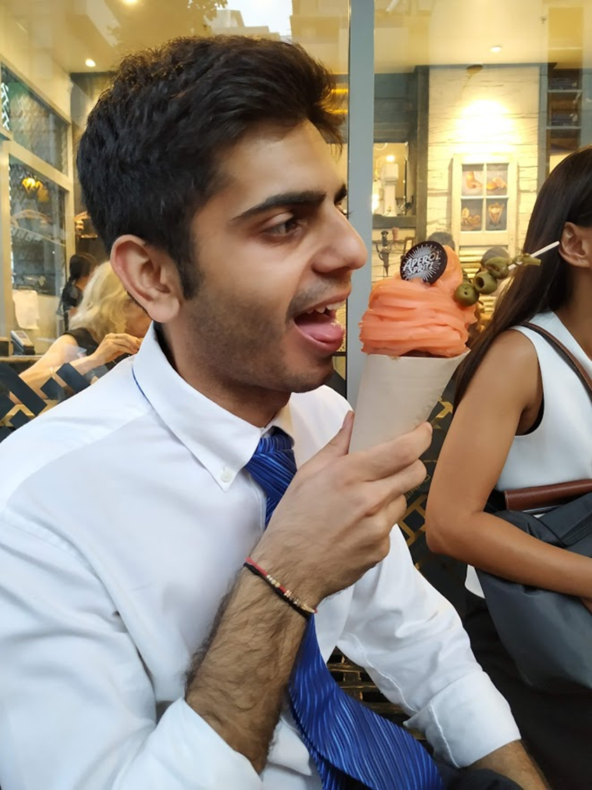



Customer journey
Strategy Walkthrough
Consumption
Invest
Family
Alvin, guitarist
Details..
Details..
Details..
Details..
Strategy walkthrough

Slide 26





Customer journey
Strategy Walkthrough
Customer journey
1
Survey to understand student interests
Students ’clock-in’ to system
Amy realizes she has a need of menstrual cramp insurance
She buys a 6-month policy from ZA from its online platform
Purchase
2
Amy experiences severe cramps on the first day of her period and could not work
She applies for a leave and visits the doctor
Amy
The unfortunate day
Age: 24
Office lady
Experience different degrees of menstrual cramps every month
Sometimes needs to seek help from doctor
3
Amy uploads her doctor certificate and files a claim for her medical expenses
Amy receives her compensation within a short period of time
Compensation
Recommendation 02 – Customer Journey

Slide 27










Omni-channel customer journey
Strategy Walkthrough
Illustrated user journey
Identification
Navigate
Discover
Purchase
Beacons
Store experience
Walking into
IUIGA Space
Finding the products on their Wishlist
Discovering new and interesting products
Next-day delivery;
Walking out hands-free
Retained loyal customer
Customers trained to purchase through IUIGA App
Customers receive push notification
AR immersive store navigation
(Customers can also request for staff assistance)
Promotions information to stimulate impulse purchases
Customers click purchase on IUIGA App; products delivered directly to their home
IUIGA App interactions
Approve/ Deny

Slide 28
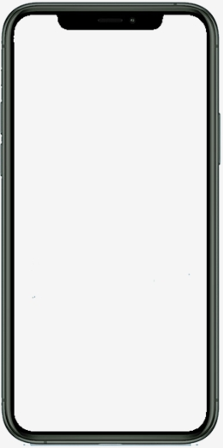


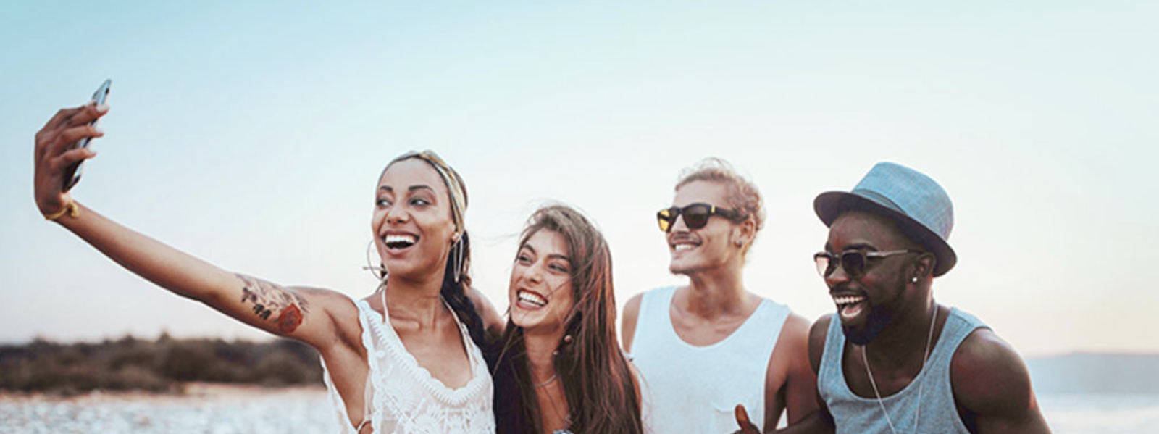
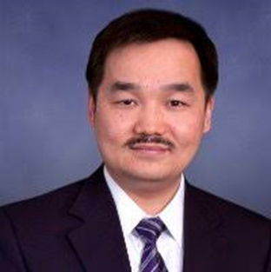

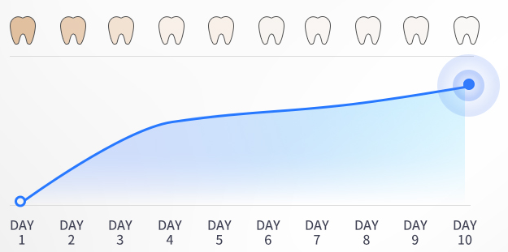
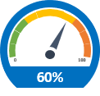



Customer UI and backend CRM
Strategy walkthrough
Colgate’s proprietary system
Purchase
Feedback
Reward
Customer-facing
Point of sales
Customizable recommended package
Promotional codes
“Dash button” for repeat purchases
Effect monitoring
Teeth whitening scores (before/after selfies)
Engagement
Customized rewards based on how much customers purchased
Flexible redemption options
Welcome back!
Way to go, Christy! Keep up the effort.
Your whitening journey
Backend
CRM
Data collection
Purchase basket
Frequency
Product usage
User experience
Reactions to different rewards
Indigo Dash
Rewards
Discover
Improved inventory management
Continuous product improvement
Enhanced incentive program

Slide 29

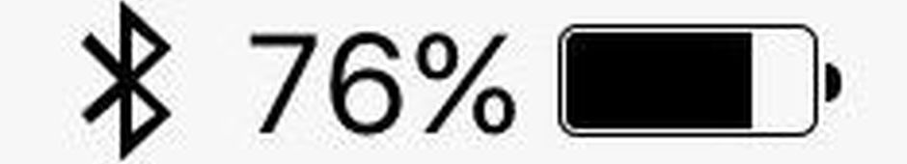
Phone
Mockup
Title (Calibri 18 pt)
Icon
Title box (20 pt)
Content (14 pt)
...
Icon
Content (14 pt)
...

Slide 30
Impact visualization
Mockup
Transparency across supply chain
∙ HELPS END GLOBAL POVERTY
Yarn
spinning
100
%
OF
PROFITS

Slide 31
Case study: Company name
Company logo/
Illustrative pic
Overview:
Impact:

Slide 32
Implementation
____________

Slide 33

Three-phase implementation
Strategy implementation
Stage 1
Stage 2: xx years into the JV
Stage 3: xx years into the JV
Content 2 (16 pt)
Content 2 (16 pt)
Content 2 (16 pt)
Stage 1
Stage 2: xx years into the JV

Slide 34
Implementation timeline
 | Year 1 |  |  |  | Year 2 |  |  |  | Year 3 |  |  |  | Year 4 |  |  |  | Year 5
Phase Out | Q1 | Q2 | Q3 | Q4 | Q1 | Q2 | Q3 | Q4 | Q1 | Q2 | Q3 | Q4 | Q1 | Q2 | Q3 | Q4 | Q1 | Q2 | Q3 | Q4
Communication with current employees
Liquidate extra properties
Ensure logistical support from production plants
Transfer
Evaluate resource utilization rate of each plant
Liaise with existing suppliers
Ensure specialization among plants
General
Conduct market research on disruptive trends
Less resource intensive
More resource intensive

Slide 35
Project Timeline
Overview
MAR
APR
MAY
UNDERSTAND CUSTOMER BAHAVIORS
Compose interview guide
Interviews (Undergraduates)
Compose interview guide
Interviews (Young working adults)
Surveys
Research insights
Research insights
INITIAL IDEAS - VETAS
Generate initial recommendations
DEVELOP FINAL RECOMMENDATIONs
In-depth research on focused strategies
Consolidate findings and final recommendations
April 10
Interim Presentation
MAY 16
Final Presentation

Slide 36
Risk and mitigation
Implementation
Risk ranking
Mitigation
1
Plan 1
This is the detail of plan 1.
Low threat
Medium threat
High threat
1
Slow increase on #trips w/ purchase
2
2
Plan 2
This is the detail of plan 2.
Experiences not welcome
Severity of risk
3
Declining visits to physical storefronts
3
Plan 3
This is the detail of plan 3.
Probability of occurrence

Slide 37
Our recommendations foster a positive feedback loop
Impact
Virtual cycle
More CSAs
OECM Wish List
Allowing OECM to accurately assess the needs of clients
Better match of service between clients and suppliers
Future outlook of our strategy
Systematically onboarding of suppliers
Descriptions
Trend packages
Proactive approach in pre-empting future needs

Slide 38
Number & chart
____________

Slide 39
KPIs
KPI
2022 TARGET
IF NOT MET?
Number of individuals in family segment reached
3%
Increase marketing effort to
raise awareness among families
Percentage from recurring donations
20.8%
Conduct surveys to analyze the reason behind one-off donors being reluctant to make recurring donates to a specific family
Cost per Dollar
0.23 AUD
Increase post-bash follow-up efforts and reduce costly marketing channels

Slide 40
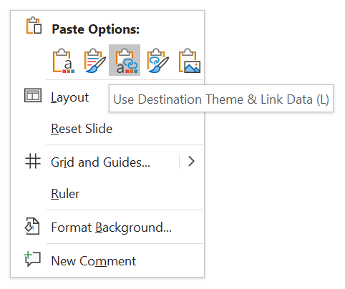
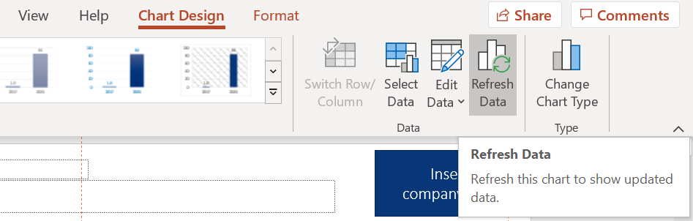
Guide to pasting charts from excel
Toolkit
1 Paste option
2 When you revise your data in excel..
Use Destination Theme & Link Data (L)
Click the chart (ppt) >> Chart Design (ribbon) >> Refresh Data >> Done!
Manually align color scheme
Manually align format

Slide 41
Financial charts: Format guide
Toolkit
Illustration
Remarks
By 2024, digital assets AUM in custody will reach US$75 bn
Have a (meaningful) chart title
AUM in custody, US$ m; CAGR, %
Always remember to put unit!
$75 bn
For Y axis, have MAX. ONE thousands separator.
111% p.a.
Label the most crucial data point.
For simplicity, drop all the background line.
$1.7 bn
Be ethical, begin the base with 0.

Slide 42
(Company) will need an upfront investment of 100mn
Financials
Cost projection (1st year)
(in CAD)
Cost breakdown..
Marketing
40 mn
Billboard (offline), KOL partnership (online)
R&D
30 mn
Development of new flavors
100
million
HR
15 mn
Hiring additional logistics personnel
Software development
15 mn
App UX/UI

Slide 43
Funnel
Market sizing
Conversion pipeline
Awareness
25%
Interest
50%
Engagement
90%
Repeat
x 1.5
Advocacy

Slide 44
Funnel
Market Sizing
TAM (Total Addressable Market) Number of registered marriages in Hong Kong (2016)
Assumptions
50,000
20% of all ceremonies arranged by full service planners
ZhongAn partners with 5% of this batch
Weddings are uniformly distributed among full-service planners
SAM (Serviceable Available Market) Number of registered marriages with wedding ceremonies planned by a full-service planner
9,000
SOM (Serviceable Obtainable Market) Weddings planned by planners partnered with ZhongAn
450
Strategy Validation - Vendors

Slide 45





Menstrual cramps insurance is potentially an attractive option for women
Recommendation 02 – Rationale
Considerations
42%
Target:
Women whose work/ daily activities are significantly affected by period cramps
Those who want to take a day off because of their period
Female
Are found to have experienced menstrual cramp that affected their work ability
One-off menstrual cramps are not foreseeable, only those who experience regular cramps are likely to purchase
The term of the period could be short-to-medium e.g. 6 months
Potential Market Size
Approximately 600,000
Period cramps are hard to be proved when filing claims except with medical certificates
Female population aged from 15 to 39:
42%
1,381,300
Source: Yougov, Statistics and Census Department, HKSAR Government

Slide 46









Online and offline marketing channels can be used to utilized
Offline
Online
Why?
Why?
Supermarket & convenience stores
Female-oriented KOLs
Direct touch point
Women actively look for products needed during period
The right audience
Makeup and workout KOLs target young female millennials
Potential marketing messages
Zhong An as a caring insurer
Zhong An understand women’s needs and we’ve got your back
Period is a blessing, not a burden
Enjoy your period because it’s carefree!
Perfect gift for your girlfriend
Basic requirement for being a boyfriend
Recommendation 02 - Marketing

Slide 47
The partnership model option set is constrained
Strategy Validation - Vendors
Available Option Set
 | Revenue-Sharing Model | Product Exclusivity | Provision of Insurance |  | Marketing Synergies
 |  |  | Wedding Event Insurance | Employee Life/Health Insurance
Feasibility
Comments | Not permitted in Hong Kong | Product exclusivity would limit reach | ZA does not have event insurance | Vendors may not have a need | ZA does not have a presence yet
Least
feasible
Most
feasible
Example

Slide 48

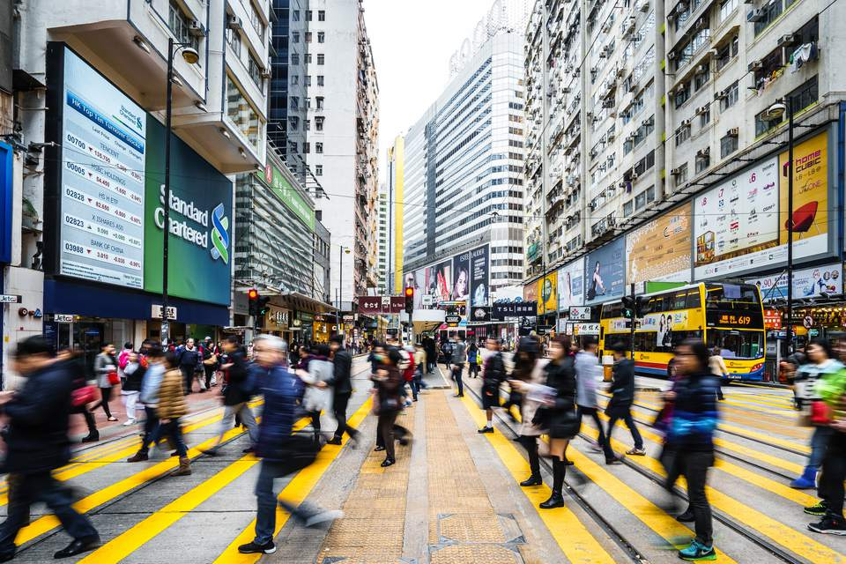


Our team assessed two segments: undergraduates and working adults
Overview
Undergraduate Students
Young Working Adults
25
interviews
32
interviews
87
surveys
The undergraduate population does not intend to purchase insurance, particularly life insurance
Focus on building brand awareness and educating this population
Most already have insurance covered, but will purchase if there are incentives provided
Focus on targeting this population through various direct and indirect channels (focus on trigger points)
Notes:
Need to determine the number of interactions

Slide 49






A number of ideas were discussed during the interim
Overview
Undergraduate Students
Young Working Adults
Marketing
Student Branding
Initiatives
Sports Insurance
Trigger Points
VHIS + Health App
Marketing and branding required for both segments
Mainland
Graduates
Startups

Slide 50
Shift in scope from interview and research insights
Project Scope
Initial Scope
1
2
3
Undergraduates
Life insurance
Marketing strategies
Insights / Interim Presentation
1
2
3
Triggering events
Needs differentiation from traditional insurance companies
Client onboarding is key to
ZA’s success in HK
Final Recommendations
Marriage Strategy
Recommendation 02

Slide 51
Wedding planners can act as the touch point for triggering events
Insights
Insurance is not a product that customers will proactively look for, nor being hard sold.
They need trigger points in life to realize the demand themselves.
Implications
ZhongAn need to identify these triggering events and effectively target the correct customer group for selling opportunities
Opportunities
One major trigger point is marriage, and so ZhongAn can cooperate with wedding planners to develop strategies and boost life insurance sales in Hong Kong
Rationale

Slide 52
Hong Kong’s wedding planner landscape
Full service
The Theme Wedding
The Wedding
Atelier
The wedding company
Only Mine
Marriage Maestros
Quintessentially Weddings
Services provided
KateMagg
White Bridal
Tiara
Bliss Creation
Bonvivant and Bellavitat
On-the day service
Timeless Event Design
Pink Diamond
wedding
Low
Price
High
Key Market
Focus on wedding planners with more serviced provided looking for additional add-on features
Strategy Focus - Vendors

Slide 53
The partnership model option set is constrained
Strategy Validation - Vendors
Available Partnership Model Option Set
 | Revenue-Sharing Model | Product Exclusivity | Provision of Insurance |  | Marketing Synergies
 |  |  | Wedding Event Insurance | Employee Life/Health Insurance
Comments | ZA gives wedding planners a share of the commission | ZA only provides the wedding insurance benefit to 1-2 providers | ZA provides the company with discounted insurance for their events | ZA provides the company’s staff with discounted insurance | ZA helps market for the wedding planner
Example
Notes:
1.
- Marketing synergies – intuitively does not make sense, ZA does not have the relevant market size/coverage yet

Slide 54
The partnership model option set is constrained
Strategy Validation - Vendors
Available Option Set
 | Revenue-Sharing Model | Product Exclusivity | Provision of Insurance |  | Marketing Synergies
 |  |  | Wedding Event Insurance | Employee Life/Health Insurance
Feasibility
Comments | Not permitted in Hong Kong | Product exclusivity would limit reach | ZA does not have event insurance | Vendors may not have a need | ZA does not have a presence yet
Least
feasible
Most
feasible
Example

Slide 55
There were difficulties faced when assessing the vendor market
OBJECTIVE
Approach wedding planners to seek potential cooperation packages
Approach 1
Insurance Company
Most interviewees didn’t want to continue the conversation after knowing us as insurance company representatives
Without disclosing ZhongAn (or any company name), it was hard to persuade interviewees to our proposals
Approach 2
Newly engaged couples
Sensitive about questions related to business operations (e.g. how many weddings do they plan per year)
Difficult to alter the conversation towards insurance related topics
Strategy Validation - Vendors
Notes:
Add “could not validate partnership model”

Slide 56
Online and offline marketing channels can be used to utilized
Offline
Online
Why?
Why?
Supermarket & convenience stores
Female-oriented KOLs
Direct touch point
Women actively look for products needed during period
The right audience
Makeup and workout KOLs target young female millennials
Potential marketing messages
Zhong An as a caring insurer
Zhong An understand women’s needs and we’ve got your back
Period is a blessing, not a burden
Enjoy your period because it’s carefree!
Perfect gift for your girlfriend
Basic requirement for being a boyfriend
Recommendation 02 - Marketing

Slide 57


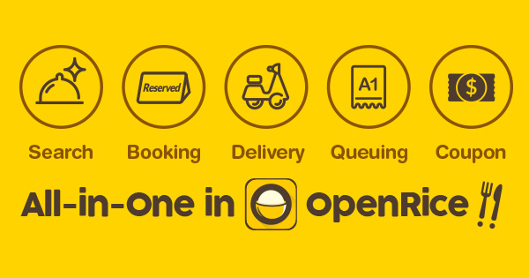
Closing the sales gap with packages meeting customers’ needs
1
2
3
Group Pack Purchase
Seasonal Offers
Close Sales
ZA Re-U Safe TM
ZA Festival Fun TM
Online Reservation
Millennials enjoy night outs in groups (hot pot, karaoke)
Group discounts can be used to utilize peer influence
Individuals go out more often during festive seasons
Package can cover the whole vacation period
Ad-space on reservation systems, e.g. OpenRice
Tap into customers at the trigger point
Strategy Implementation – Night Out
57

